Slide 1
Network Intrusion Detection System (NIDS) using Machine Learning
CAPSTONE PROJECT
Presented By:
Name:-
Shrikrushna Deokar
College :-
Pimpri chinchwad college of engineering & Research
Department:-
Computer engineering

Slide 2
OUTLINE
Problem Statement (Should not include solution)
Proposed System/Solution
System Development Approach (Technology Used)
Algorithm & Deployment
Result (Output Image)
Conclusion
Future Scope
References

Slide 3
Problem Statement
Create a robust network intrusion detection system (NIDS) using machine learning. The system should be capable of analyzing network traffic data to identify and classify various types of cyber-attacks (e.g., DoS, Probe, R2L, U2R) and distinguish them from normal network activity. The goal is to build a model that can effectively secure communication networks by providing an early warning of malicious activities.

Slide 4
Proposed Solution
The proposed system aims to address the challenge of securing communication networks by detecting cyber-attacks using machine learning. The solution includes the following key components:
Data Collection:
Use labeled network traffic data containing both normal and malicious activities
Dataset includes various attack types like DoS, Probe, R2L, and U2R.
Data Preprocessing:
Clean the data by handling missing values and removing inconsistencies.
Perform feature engineering to select the most important network traffic features for training.
Machine Learning Algorithm:
Train a binary classification model using AutoAI in IBM Watsonx.ai Studio.
Algorithm used: Snap Random Forest Classifier..
OOTPUT Lable : normal or anomaly.
Deployment:
Evaluate the model's performance using metrics like accuracy and confidence level.
Enable real-time prediction of network traffic as safe or potentially harmful.
Evaluate the model's performance using metrics like accuracy and confidence level.

Slide 5
System Approach
Technologies Used:
Platform: IBM Watsonx.ai Studio
Language: Python (AutoAI/AutoML on IBM Cloud)
Libraries/Tools: Pandas, Scikit-learn (in background), AutoML
Dataset: Publicly available intrusion detection dataset with features like:
protocol_type, service, flag, src_bytes, dst_bytes, etc.
Training File Used: Train_data.csv Testing File Used: Test_data.csv

Slide 6
Algorithm & Deployment
In the Algorithm section, describe the machine learning algorithm chosen for predicting bike counts. Here's an example structure for this section:
Algorithm Used
Snap Random Forest Classifier (AutoAI selected)
Ensemble method with high accuracy (99.5%)
Training Process
Used IBM Watson AutoAI with Train_data.csv
Automated feature selection, preprocessing, and HPO
Training completed in just 22 seconds
Model Deployment
Deployed via IBM Watson Machine Learning as REST API
Supports real-time predictions and easy integration

Slide 7
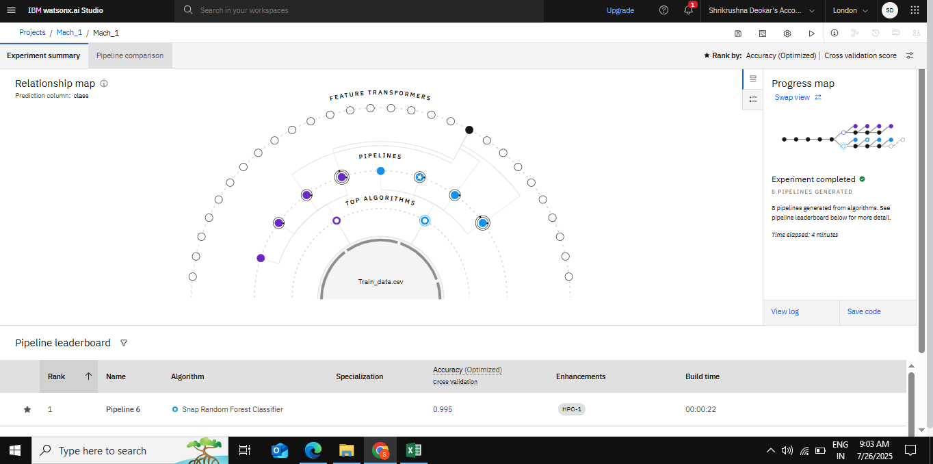
Result
Here we can train model using data

Slide 8
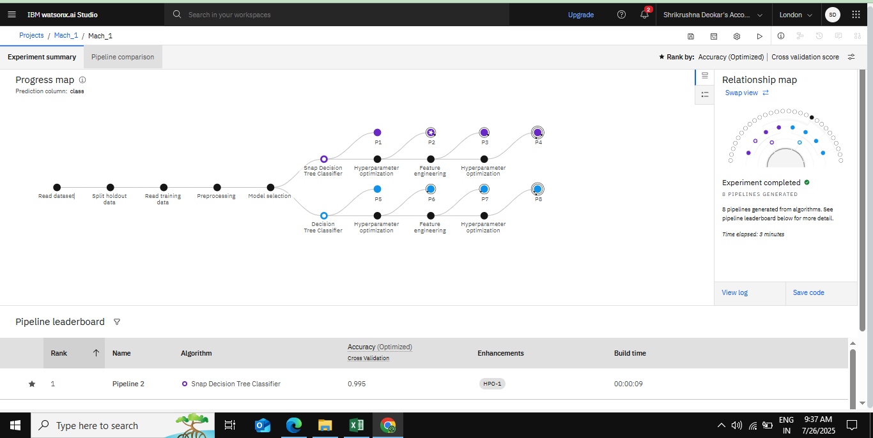
Result

Slide 9
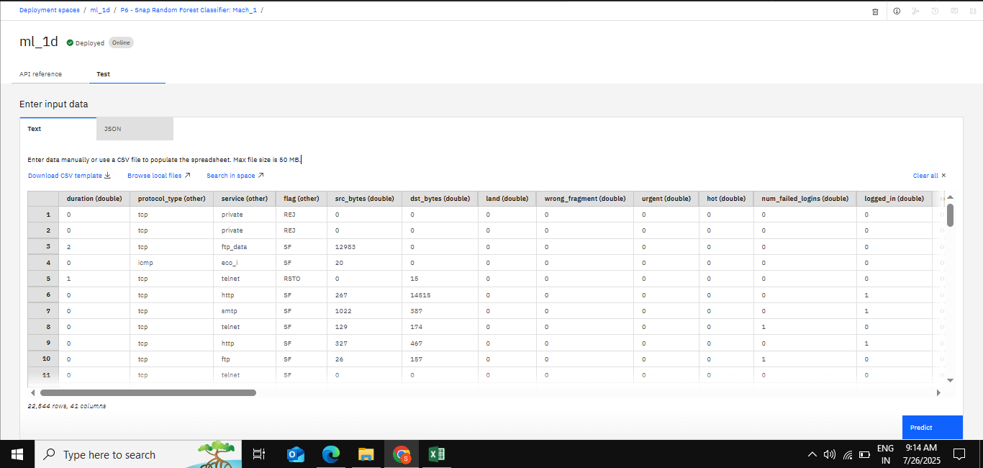
Result
Here we can upload data for test the model .

Slide 10
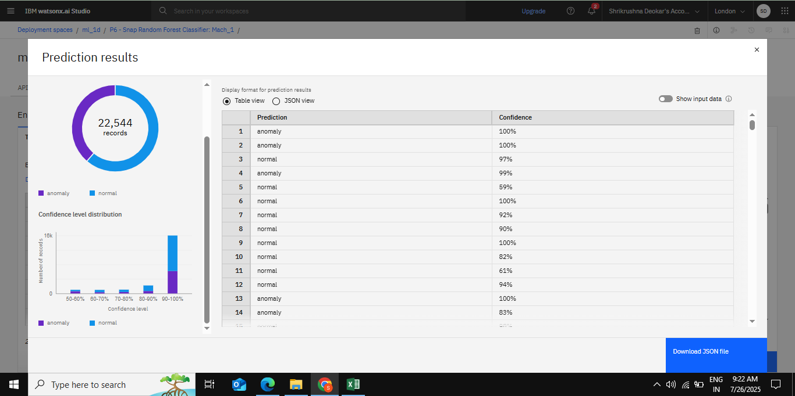
Result
Here prediction final results.

Slide 11
Conclusion
We successfully developed and deployed a Machine Learning-based Network Intrusion Detection System (NIDS) capable of accurately identifying and classifying various types of cyber-attacks in real time. By analyzing network traffic patterns, the system can effectively distinguish between normal and anomalous activities. The use of ML enhances detection capabilities, enabling early warning and proactive responses to threats like DoS, R2L, and U2R attacks. Compared to traditional static rule-based systems, this approach offers greater flexibility and accuracy. Overall, the project demonstrates how AI can strengthen cybersecurity infrastructure and minimize potential damage.

Slide 12
Future scope
In the future, the system can be extended to perform multi-class classification, allowing it to detect and identify specific types of cyber-attacks such as DoS, R2L, U2R, and Probe. The integration of real-time alert mechanisms using streaming data technologies like Apache Kafka or Spark can help in prompt threat detection and response. Furthermore, the system can be connected to existing firewall and antivirus solutions to enable automatic threat mitigation. To enhance the detection accuracy and adaptiveness, advanced deep learning models like Convolutional Neural Networks (CNNs) or Long Short-Term Memory networks (LSTMs) can be explored and implemented.

Slide 13
References
IBM Watsonx.ai Documentation: https://www.ibm.com/docs/en/watsonx
Dataset Source – KDD Cup 1999 (Network Intrusion Detection Dataset): http://kdd.ics.uci.edu/databases/kddcup99/kddcup99.html
Scikit-learn Machine Learning Library Documentation: https://scikit-learn.org/stable/documentation.html
Cybersecurity Research Papers and Tutorials: IEEE Xplore, SpringerLink, ResearchGate
Python Official Documentation: https://docs.python.org/3/

Slide 14

IBM Certifications

Slide 15

IBM Certifications

Slide 16

IBM Certifications

Slide 17
THANK YOU

